Slide 1
Online Recruitment System
A Web Based Recruitment Tool

Slide 2
Overview
Why Online Recruitment
Features
Software requirement
Hardware Requirement
Tools and Technologies
Working of System (System Division)
Sample Report
Further Enhancement
Conclusion

Slide 3
Why Online Recruitment System
Less Human Involvement
Faster
Reduced Paper Handling
User Friendly
Less Cost
History Record

Slide 4
Features
Generation of result w.r.t test given by candidates.
Creating new User/Admin profile.
Modifying profiles.
Accessing database is fast.
Questions viewed by the candidates on their desktop will be different .

Slide 5
Features(contd)
Candidate enrollment in the company.
Provides interface to candidate to select test category for examination.
Test taking and Test Evaluation.
Test, Question, Category creation facility.
Editing existing Test/Question/Category.
Maintaining a log for tracking error and debugging

Slide 6
Software and Hardware Recommendations
Windows 9x/2K/XP
Oracle 8i Enterprise Edition
JDK 1.5.0
Apache tomcat 4.0.1
Network Interface Card
P-IV PC

Slide 7
Tools and Technologies
Java Server Pages:
  Reuse of Components and tags.
  Separating Content Generation from Presentation.
  Separation of dynamic and static content.
  Support for Scripting tags.
  Platform Independence.
  Power of Server Side Java

Slide 8
Java Servlet
Better than CGI
Efficiency
Persistent
Robustness
Extensibility
Security

Slide 9
Contd…
Java Script and HTML
  Object Based.
  Cross Platform
  Loosely typed
  Security
  Multi use Language.
Apache Tomcat Java Web Server

Slide 10
Benefits of the system
Customizes the test pattern
Provides log for detecting failures in the system
Maintains a session for each user thus providing adequate privacy, security
Random Questions are generated for each User
Bio-data of any candidate can be viewed instantly

Slide 11
Benefits(contd..)
Performs necessary functions required for distributed computing such as
  Concurrent access
  Request validations
  Concurrent processing
  System is secure from request replaying as server validates each request from user with current session entries

Slide 12
Overview of System
Online Recruitment
System
Admin
Sub
System
User
Sub
System
Database
Sub
System

Slide 13
Administrator Sub System
Admin
Sub
System
Log
Manager
Question
Manager
Result
Manager
User
Manager
Exam
Manager
Post Manager

Slide 14
User Sub System
User
Sub
System
User
Authentication
Result
Evaluation
Question
Generation
Post
Validation

Slide 15
Database Sub System
Database
Sub
System
Connection
Pool
Manager

Slide 16

Three Tier Architecture
Client Tier
Middle Tier
Company
Information
System
Bean
container
Browser
Database
Web
Container
JDBC
Servlet
JSP

Slide 17

Admin Activities
Creation of admin account..
Edit or Delete Admin.
Add new course to the application.
Select and Create new questions under earlier created course.
Select new post for the test and view the post.

Slide 18
Admin Activities(contd)
Result view and list users according to that.
Edit or delete existing Category
View log

Slide 19

User Activity
Create User Account
Category Selection
Test Procedure and Warning
Test Starts
Vote of thanks is displayed

Slide 20
Further Enhancement
Data Encryption.
Descriptive questions may be included.
May also include Multimedia related Questions.
Vacancy management may be provided
System must be able to inform selected users automatically via email.

Slide 21
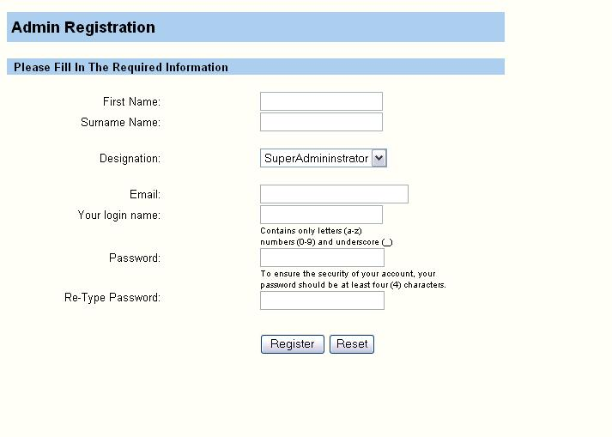
Admin Registration Page

Slide 22
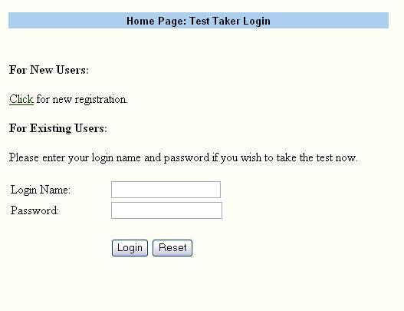
User Login Page

Slide 23
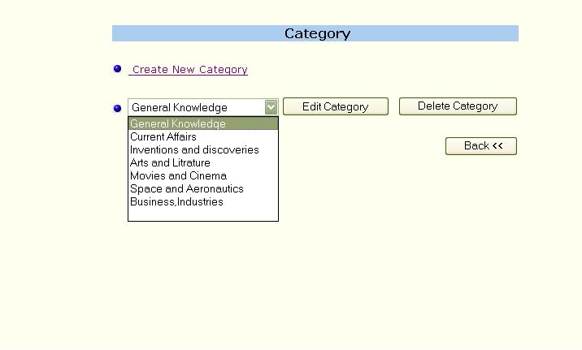
Category Creation

Slide 24
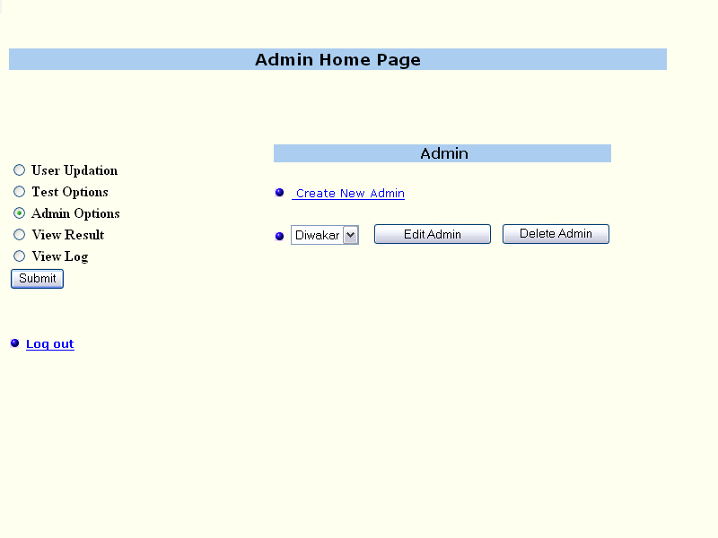
Create Admin Page

Slide 25
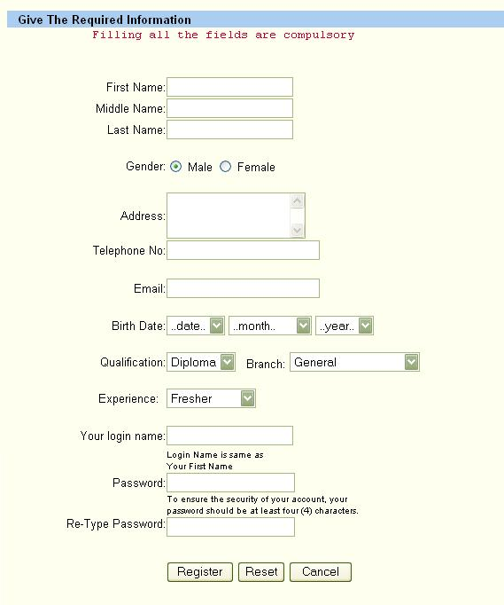
User Registration

Slide 26
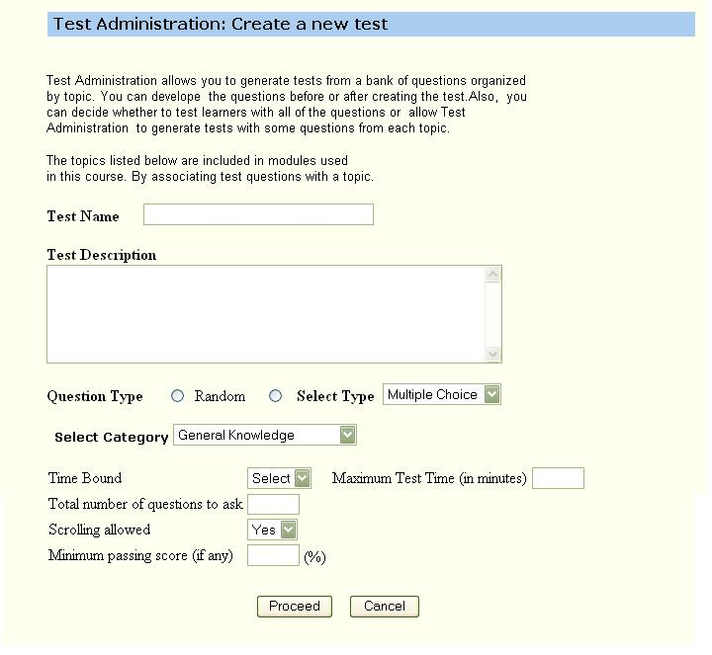
Test Creation

Slide 27
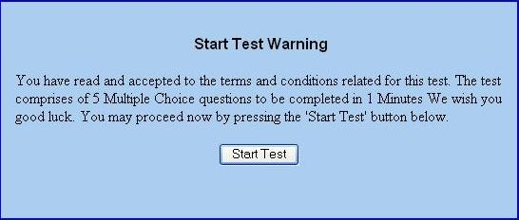
Warning

Slide 28
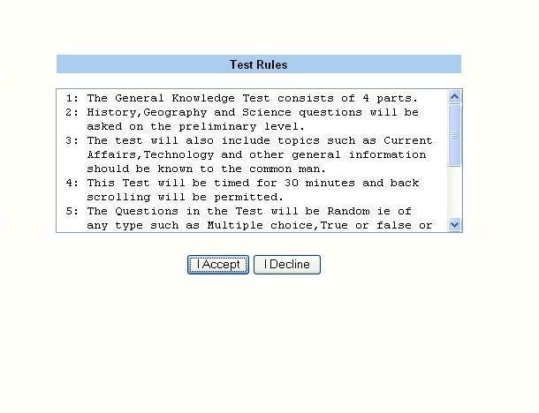
Test Rules

Slide 29
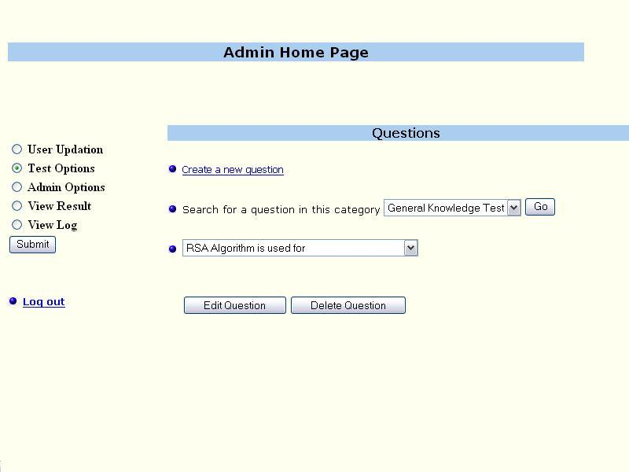
Updating Question

Slide 30
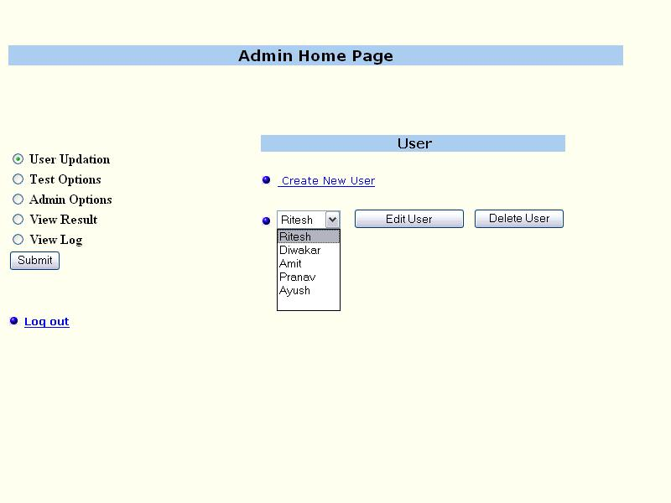
Updating User

Slide 31
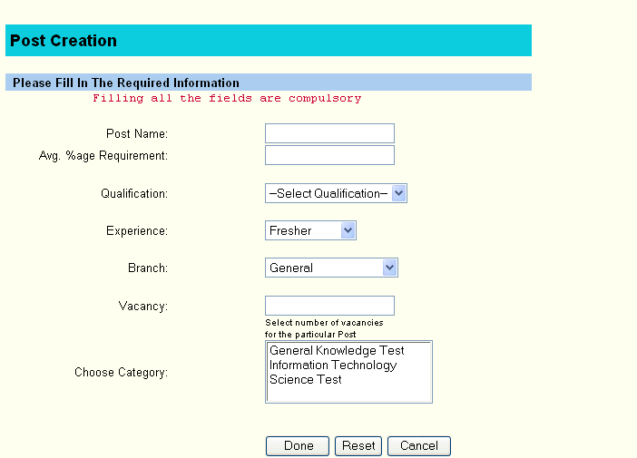
Post Creation

Slide 32
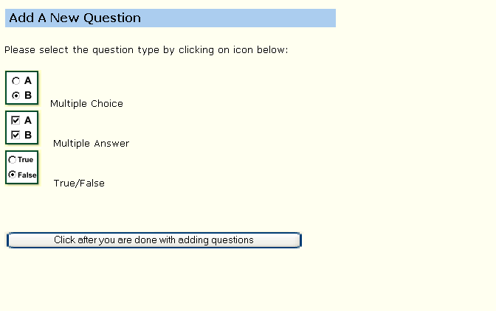
Add new question type

Slide 33
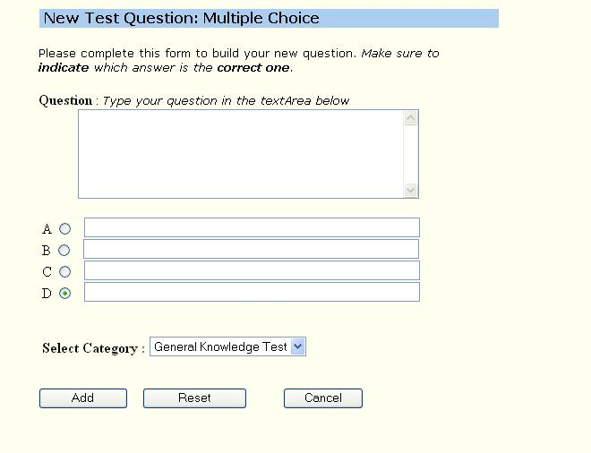
Create new question

Slide 34
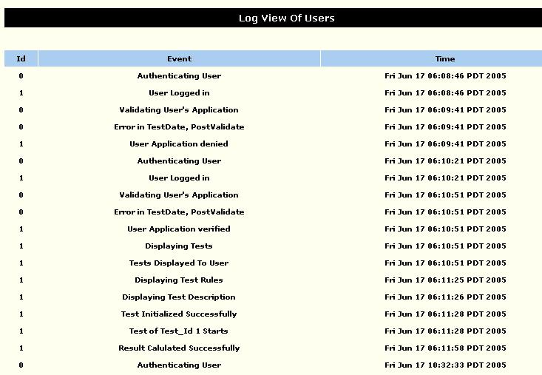
Log view

Slide 35
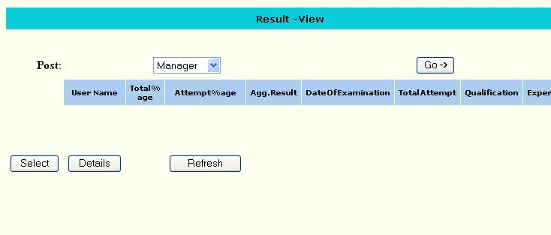
Result view

Slide 36
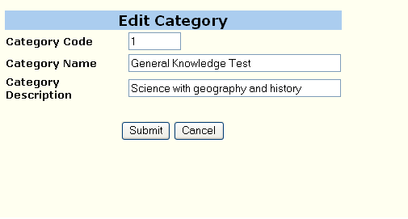
Edit category

Slide 37
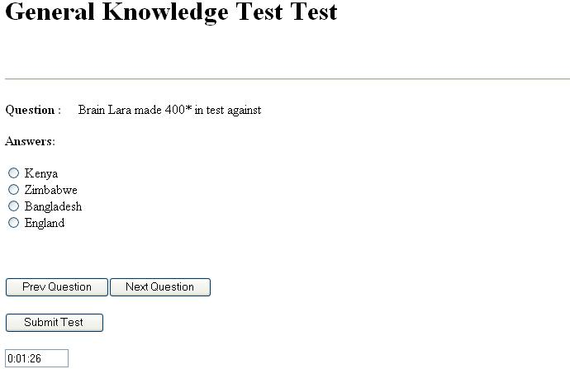
Test starts

Slide 38
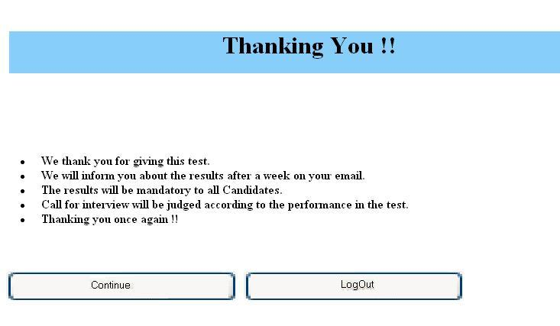
Vote of thanks

Slide 39
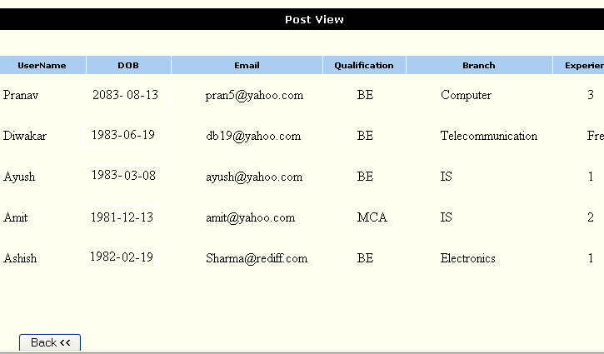
Post view

Slide 40
Conclusion
The system will hopefully ease the job of the organizations but will also provide-:
  Efficient record management
  Dynamic paper setting
  Facilitate large scale examination

